Slide 1
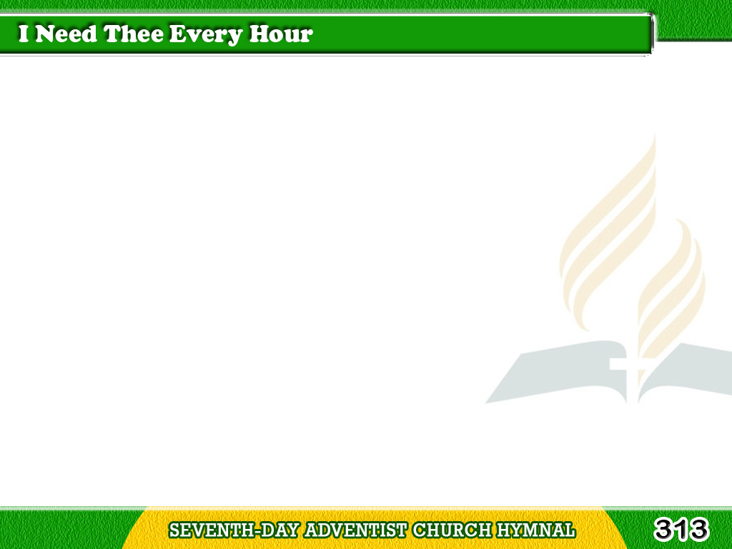
1/4
I need Thee every hour,
Most gracious Lord;
No tender voice like Thine
Can peace afford.
Tagalog
Version

Slide 2
1/4
Chorus
I need Thee, O I need Thee;
Every hour I need Thee!
O bless me now, my Savior
I come to Thee.
Tagalog
Version

Slide 3
2/4
I need Thee every hour,
Stay Thou near by;
Temptations lose their power
When Thou art nigh.
Tagalog
Version

Slide 4
2/4
Chorus
I need Thee, O I need Thee;
Every hour I need Thee!
O bless me now, my Savior
I come to Thee.
Tagalog
Version

Slide 5
3/4
I need Thee every hour,
In joy or pain;
Come quickly, and abide,
Or life is vain.
Tagalog
Version

Slide 6
3/4
Chorus
I need Thee, O I need Thee;
Every hour I need Thee!
O bless me now, my Savior
I come to Thee.
Tagalog
Version

Slide 7
4/4
I need Thee every hour,
Teach me Thy will,
And Thy rich promises
In me fulfill.
Tagalog
Version

Slide 8
4/4
Chorus
I need Thee, O I need Thee;
Every hour I need Thee!
O bless me now, my Savior
I come to Thee.
Tagalog
Version

